Slide 1

Chapter 10
Error Detection
and
Correction
10.<number>
Copyright © The McGraw-Hill Companies, Inc. Permission required for reproduction or display.

Slide 2

Note
Data can be corrupted
during transmission.
Some applications require that
errors be detected and corrected.
10.<number>

Slide 3
10-1 INTRODUCTION
Let us first discuss some issues related, directly or indirectly, to error detection and correction.
Topics discussed in this section:
Types of Errors
Redundancy
Detection Versus Correction
Forward Error Correction Versus Retransmission
Coding
Modular Arithmetic
10.<number>

Slide 4
Note
In a single-bit error, only 1 bit in the data unit has changed.
10.<number>

Slide 5

Figure 10.1 Single-bit error
10.<number>

Slide 6
Note
A burst error means that 2 or more bits in the data unit have changed.
10.<number>

Slide 7

Figure 10.2 Burst error of length 8
10.<number>

Slide 8
Note
To detect or correct errors, we need to send extra (redundant) bits with data.
10.<number>

Slide 9

Figure 10.3 The structure of encoder and decoder
10.<number>

Slide 10
Note
In this book, we concentrate on block codes; we leave convolution codes
to advanced texts.
10.<number>

Slide 11
Note
In modulo-N arithmetic, we use only the integers in the range 0 to N −1, inclusive.
10.<number>

Slide 12

Figure 10.4 XORing of two single bits or two words
10.<number>

Slide 13
10-2 BLOCK CODING
In block coding, we divide our message into blocks, each of k bits, called datawords. We add r redundant bits to each block to make the length n = k + r. The resulting n-bit blocks are called codewords.
Topics discussed in this section:
Error Detection
Error Correction
Hamming Distance
Minimum Hamming Distance
10.<number>

Slide 14

Figure 10.5 Datawords and codewords in block coding
10.<number>

Slide 15
Example 10.1
The 4B/5B block coding discussed in Chapter 4 is a good example of this type of coding. In this coding scheme,
k = 4 and n = 5. As we saw, we have 2^{k} = 16 datawords and 2^{n} = 32 codewords. We saw that 16 out of 32 codewords are used for message transfer and the rest are either used for other purposes or unused.
10.<number>

Slide 16
Error Detection
Enough redundancy is added to detect an error.
The receiver knows an error occurred but does not know which bit(s) is(are) in error.
Has less overhead than error correction.
10.<number>

Slide 17

Figure 10.6 Process of error detection in block coding
10.<number>

Slide 18
Example 10.2
Let us assume that k = 2 and n = 3. Table 10.1 shows the list of datawords and codewords. Later, we will see how to derive a codeword from a dataword.
Assume the sender encodes the dataword 01 as 011 and
sends it to the receiver. Consider the following cases:
1. The receiver receives 011. It is a valid codeword. The
receiver extracts the dataword 01 from it.
10.<number>

Slide 19
Example 10.2 (continued)
2. The codeword is corrupted during transmission, and
111 is received. This is not a valid codeword and is
discarded.
3. The codeword is corrupted during transmission, and
000 is received. This is a valid codeword. The receiver
incorrectly extracts the dataword 00. Two corrupted
bits have made the error undetectable.
10.<number>

Slide 20

Table 10.1 A code for error detection (Example 10.2)
10.<number>

Slide 21
Note
An error-detecting code can detect
only the types of errors for which it is designed; other types of errors may remain undetected.
10.<number>

Slide 22

Figure 10.7 Structure of encoder and decoder in error correction
10.<number>

Slide 23
Example 10.3
Let us add more redundant bits to Example 10.2 to see if the receiver can correct an error without knowing what was actually sent. We add 3 redundant bits to the 2-bit dataword to make 5-bit codewords. Table 10.2 shows the datawords and codewords. Assume the dataword is 01. The sender creates the codeword 01011. The codeword is corrupted during transmission, and 01001 is received. First, the receiver finds that the received codeword is not in the table. This means an error has occurred. The receiver, assuming that there is only 1 bit corrupted, uses the following strategy to guess the correct dataword.
10.<number>

Slide 24
Example 10.3 (continued)
1. Comparing the received codeword with the first codeword in the table (01001 versus 00000), the receiver decides that the first codeword is not the one that was sent because there are two different bits.
2. By the same reasoning, the original codeword cannot be the third or fourth one in the table.
3. The original codeword must be the second one in the table because this is the only one that differs from the received codeword by 1 bit. The receiver replaces 01001 with 01011 and consults the table to find the dataword 01.
10.<number>

Slide 25

Table 10.2 A code for error correction (Example 10.3)
10.<number>

Slide 26

Note
10.

Slide 27

Example 10.4
Let us find the Hamming distance between two pairs of words.
1. The Hamming distance d(000, 011) is 2 because
2. The Hamming distance d(10101, 11110) is 3 because
10.

Slide 28
Note
The minimum Hamming distance is the smallest Hamming distance between
all possible pairs in a set of words.
10.

Slide 29
Example 10.5
Find the minimum Hamming distance of the coding scheme in Table 10.1.
Solution
We first find all Hamming distances.
The d_{min} in this case is 2.
10.

Slide 30
Example 10.6
Find the minimum Hamming distance of the coding scheme in Table 10.2.
Solution
We first find all the Hamming distances.
The d_{min} in this case is 3.
10.

Slide 31
Note
To guarantee the detection of up to s errors in all cases, the minimum
Hamming distance in a block
code must be d_{min} = s + 1.
10.

Slide 32
Example 10.7
The minimum Hamming distance for our first code scheme (Table 10.1) is 2. This code guarantees detection of only a single error. For example, if the third codeword (101) is sent and one error occurs, the received codeword does not match any valid codeword. If two errors occur, however, the received codeword may match a valid codeword and the errors are not detected.
10.

Slide 33
Example 10.8
Our second block code scheme (Table 10.2) has d_{min} = 3. This code can detect up to two errors. Again, we see that when any of the valid codewords is sent, two errors create a codeword which is not in the table of valid codewords. The receiver cannot be fooled.
However, some combinations of three errors change a valid codeword to another valid codeword. The receiver accepts the received codeword and the errors are undetected.
10.

Slide 34
Note
To guarantee correction of up to t errors in all cases, the minimum Hamming distance in a block code
must be d_{min} = 2t + 1.
10.

Slide 35
Example 10.9
A code scheme has a Hamming distance d_{min} = 4. What is the error detection and correction capability of this scheme?
Solution
This code guarantees the detection of up to three errors
(s = 3), but it can correct up to one error. In other words,
if this code is used for error correction, part of its capability is wasted. Error correction codes need to have an odd minimum distance (3, 5, 7, . . . ).
10.

Slide 36
10-3 LINEAR BLOCK CODES
Almost all block codes used today belong to a subset called linear block codes. A linear block code is a code in which the exclusive OR (addition modulo-2) of two valid codewords creates another valid codeword.
Topics discussed in this section:
Minimum Distance for Linear Block Codes
Some Linear Block Codes
10.

Slide 37
Note
In a linear block code, the exclusive OR (XOR) of any two valid codewords creates another valid codeword.
10.

Slide 38
Example 10.10
Let us see if the two codes we defined in Table 10.1 and Table 10.2 belong to the class of linear block codes.
1. The scheme in Table 10.1 is a linear block code
because the result of XORing any codeword with any
other codeword is a valid codeword. For example, the
XORing of the second and third codewords creates the
fourth one.
2. The scheme in Table 10.2 is also a linear block code.
We can create all four codewords by XORing two
other codewords.
10.

Slide 39
Example 10.11
In our first code (Table 10.1), the numbers of 1s in the nonzero codewords are 2, 2, and 2. So the minimum Hamming distance is d_{min} = 2. In our second code (Table 10.2), the numbers of 1s in the nonzero codewords are 3, 3, and 4. So in this code we have d_{min} = 3.
10.

Slide 40
Note
A simple parity-check code is a
single-bit error-detecting
code in which
n = k + 1 with d_{min} = 2.
Even parity (ensures that a codeword has an even number of 1’s) and odd parity (ensures that there are an odd number of 1’s in the codeword)
10.

Slide 41
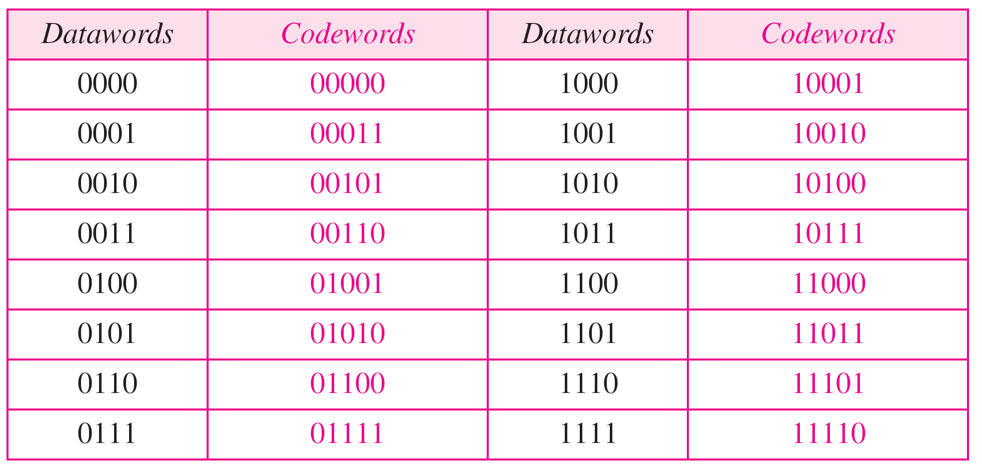
Table 10.3 Simple parity-check code C(5, 4)
10.

Slide 42

Figure 10.10 Encoder and decoder for simple parity-check code
10.

Slide 43
Example 10.12
Let us look at some transmission scenarios. Assume the sender sends the dataword 1011. The codeword created from this dataword is 10111, which is sent to the receiver. We examine five cases:
1. No error occurs; the received codeword is 10111. The
syndrome is 0. The dataword 1011 is created.
2. One single-bit error changes a₁ . The received
codeword is 10011. The syndrome is 1. No dataword
is created.
3. One single-bit error changes r₀ . The received codeword
is 10110. The syndrome is 1. No dataword is created.
10.

Slide 44
Example 10.12 (continued)
4. An error changes r₀ and a second error changes a₃ .
The received codeword is 00110. The syndrome is 0.
The dataword 0011 is created at the receiver. Note that
here the dataword is wrongly created due to the
syndrome value.
5. Three bits—a₃, a₂, and a₁—are changed by errors.
The received codeword is 01011. The syndrome is 1.
The dataword is not created. This shows that the simple
parity check, guaranteed to detect one single error, can
also find any odd number of errors.
10.

Slide 45
Note
A simple parity-check code can detect an odd number of errors.
10.

Slide 46
Note
All Hamming codes discussed in this book have d_{min} = 3 (2 bit error detection and single bit error correction).
A codeword consists of n bits of which k are data bits and r are check bits.
Let m = r, then we have: n = 2^{m} -1
and k = n-m
10.

Slide 47
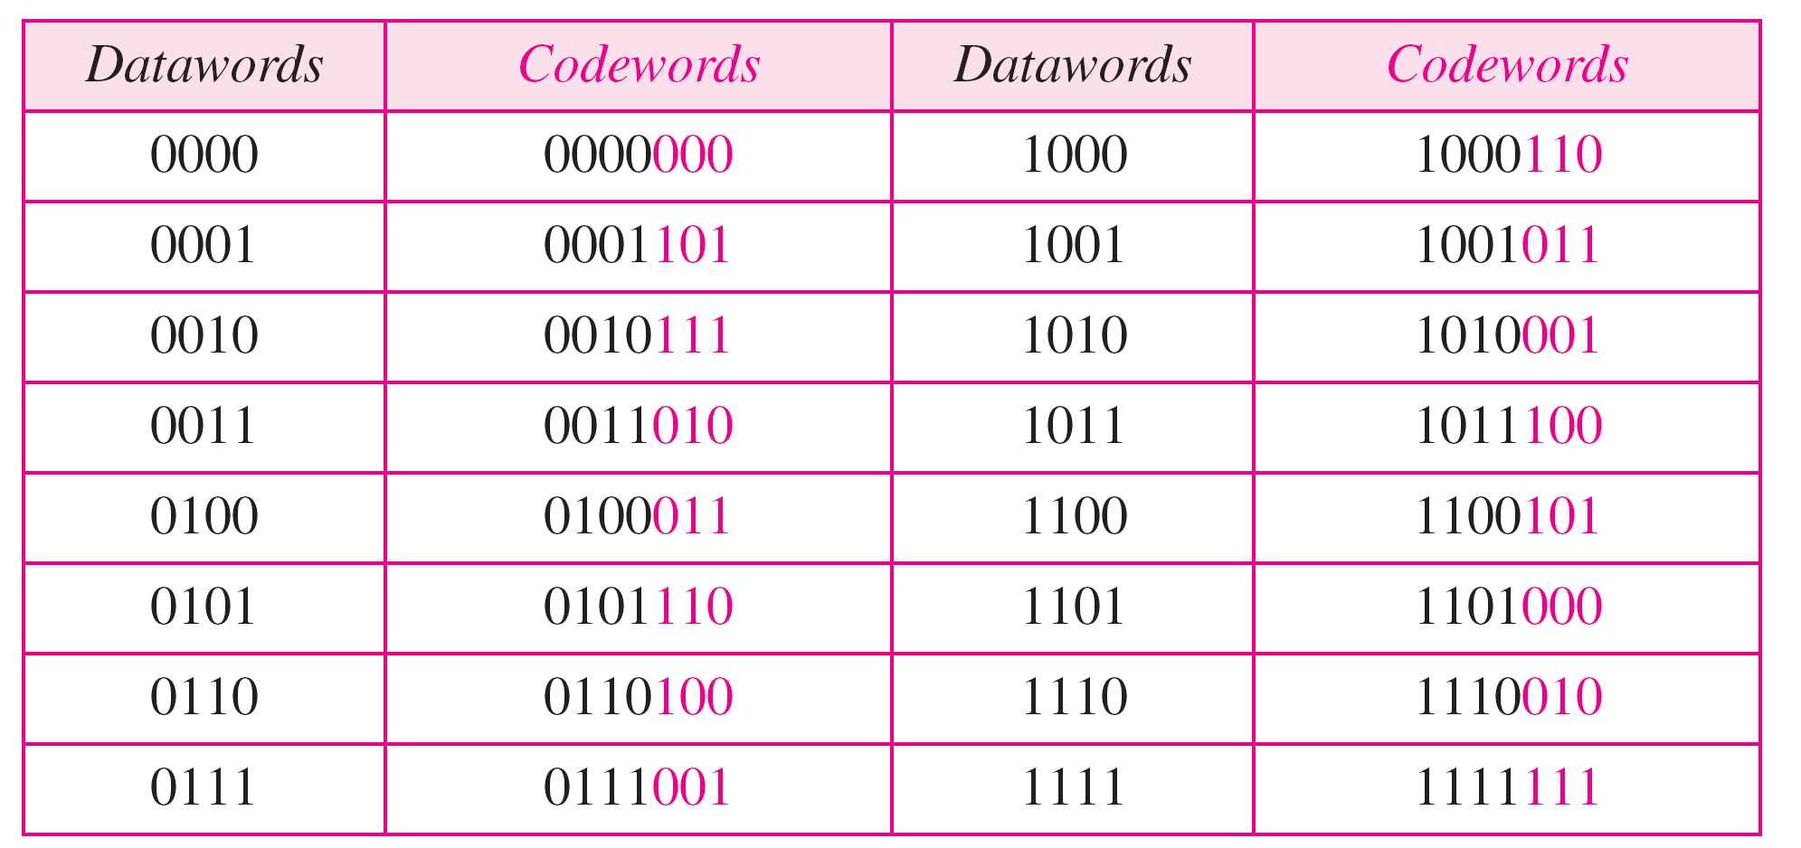
Table 10.4 Hamming code C(7, 4) - n=7, k = 4
10.

Slide 48
Calculating the parity bits at the transmitter
:
Modulo 2 arithmetic:
r0 = a2 + a1 + a0
r1 = a3 + a2 + a1
r2 = a1 + a0 + a3
Calculating the syndrome at the receiver:
s0 = b2 + b1 + b0 + q0
s1 = b3 + b2 + b1 + q1
s2 = b1 + b0 + b3 + q2
10.

Slide 49

Figure 10.12 The structure of the encoder and decoder for a Hamming code
10.

Slide 50

Table 10.5 Logical decision made by the correction logic analyzer
10.

Slide 51
Example 2
Let us trace the path of three datawords from the sender to the destination:
1. The dataword 0100 becomes the codeword 0100011.
The codeword 0100011 is received. The syndrome is
000, the final dataword is 0100.
2. The dataword 0111 becomes the codeword 0111001.
if the received codeword is 0011001 the syndrome is 011. After flipping b₂ (changing the 0 to 1), the final dataword is 0111.
3. The dataword 1101 becomes the codeword 1101000. The codeword 0001000 is received (two errors). The syndrome is 101. After flipping b₀ , we get 0000, the wrong dataword. This shows that our code cannot correct two errors.

Slide 52
Burst Errors
Burst errors are very common, in particular in wireless environments where a fade will affect a group of bits in transit. The length of the burst is dependent on the duration of the fade.
One way to counter burst errors, is to break up a transmission into shorter words and create a block (one word per row), then have a parity check per word.
The words are then sent column by column. When a burst error occurs, it will affect 1 bit in several words as the transmission is read back into the block format and each word is checked individually.

Slide 53

Figure 10.13 Burst error correction using Hamming code
10.

Slide 54
10-4 CYCLIC CODES
Cyclic codes are special linear block codes with one extra property. In a cyclic code, if a codeword is cyclically shifted (rotated), the result is another codeword.
Topics discussed in this section:
Cyclic Redundancy Check (CRC)
Polynomials
Cyclic Code Analysis
Advantages of Cyclic Codes
Other Cyclic Codes
10.

Slide 55

Table 10.6 A CRC code with C(7, 4)
10.

Slide 56

Figure 10.14 CRC encoder and decoder
10.

Slide 57

Figure 10.15 Division in CRC encoder
10.

Slide 58

Figure 10.16 Division in the CRC decoder for two cases
10.

Slide 59
Using Polynomials
We can use a polynomial to represent a binary word.
Each bit from right to left is mapped onto a power term.
The rightmost bit represents the “0” power term. The bit next to it the “1” power term, etc.
If the bit is of value zero, the power term is deleted from the expression.

Slide 60

Figure 10.21 A polynomial to represent a binary word
10.

Slide 61

Figure 10.22 CRC division using polynomials
Dataword 1001 is represented as x³ + 1
The Divisor 1011 is represented by x³ + x + 1
10.

Slide 62
Note
The divisor in a cyclic code is normally called the generator polynomial
or simply the generator.
10.

Slide 63
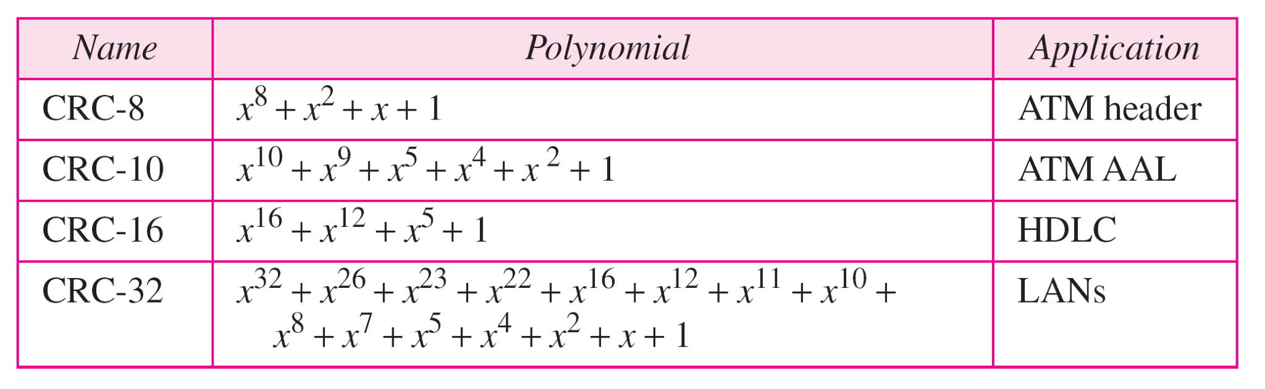
Table 10.7 Standard polynomials
10.

Slide 64
10-5 CHECKSUM
The last error detection method we discuss here is called the checksum. The checksum is used in the Internet by several protocols although not at the data link layer. However, we briefly discuss it here to complete our discussion on error checking
Topics discussed in this section:
Idea
One’s Complement
Internet Checksum
10.

Slide 65
Example 10.18
Suppose our data is a list of five 4-bit numbers that we want to send to a destination. In addition to sending these numbers, we send the sum of the numbers. For example, if the set of numbers is (7, 11, 12, 0, 6), we send (7, 11, 12, 0, 6, 36), where 36 is the sum of the original numbers. The receiver adds the five numbers and compares the result with the sum. If the two are the same, the receiver assumes no error, accepts the five numbers, and discards the sum. Otherwise, there is an error somewhere and the data are not accepted.
10.

Slide 66
Example 10.19
We can make the job of the receiver easier if we send the negative (complement) of the sum, called the checksum. In this case, we send (7, 11, 12, 0, 6, −36). The receiver can add all the numbers received (including the checksum). If the result is 0, it assumes no error; otherwise, there is an error.
10.

Slide 67
Example 10.20
How can we represent the number 21 in one’s complement arithmetic using only four bits?
Solution
The number 21 in binary is 10101 (it needs five bits). We can wrap the leftmost bit and add it to the four rightmost bits. We have (0101 + 1) = 0110 or 6.
10.

Slide 68
Example 10.21
How can we represent the number −6 in one’s complement arithmetic using only four bits?
Solution
In one’s complement arithmetic, the negative or complement of a number is found by inverting all bits. Positive 6 is 0110; negative 6 is 1001. If we consider only unsigned numbers, this is 9. In other words, the complement of 6 is 9. Another way to find the complement of a number in one’s complement arithmetic is to subtract the number from 2^{n} − 1 (16 − 1 in this case).
10.

Slide 69
Example 10.22
Let us redo Exercise 10.19 using one’s complement arithmetic. Figure 10.24 shows the process at the sender and at the receiver. The sender initializes the checksum to 0 and adds all data items and the checksum (the checksum is considered as one data item and is shown in color). The result is 36. However, 36 cannot be expressed in 4 bits. The extra two bits are wrapped and added with the sum to create the wrapped sum value 6. In the figure, we have shown the details in binary. The sum is then complemented, resulting in the checksum value 9 (15 − 6 = 9). The sender now sends six data items to the receiver including the checksum 9.
10.

Slide 70
Example 10.22 (continued)
The receiver follows the same procedure as the sender. It adds all data items (including the checksum); the result is 45. The sum is wrapped and becomes 15. The wrapped sum is complemented and becomes 0. Since the value of the checksum is 0, this means that the data is not corrupted. The receiver drops the checksum and keeps the other data items. If the checksum is not zero, the entire packet is dropped.
10.

Slide 71

Figure 10.24 Example 10.22
10.

Slide 72
Note
Sender site:
1. The message is divided into 16-bit words.
2. The value of the checksum word is set to 0.
3. All words including the checksum are
added using one’s complement addition.
4. The sum is complemented and becomes the
checksum.
5. The checksum is sent with the data.
10.

Slide 73
Note
Receiver site:
1. The message (including checksum) is
divided into 16-bit words.
2. All words are added using one’s
complement addition.
3. The sum is complemented and becomes the
new checksum.
4. If the value of checksum is 0, the message
is accepted; otherwise, it is rejected.
10.

